Slide 1
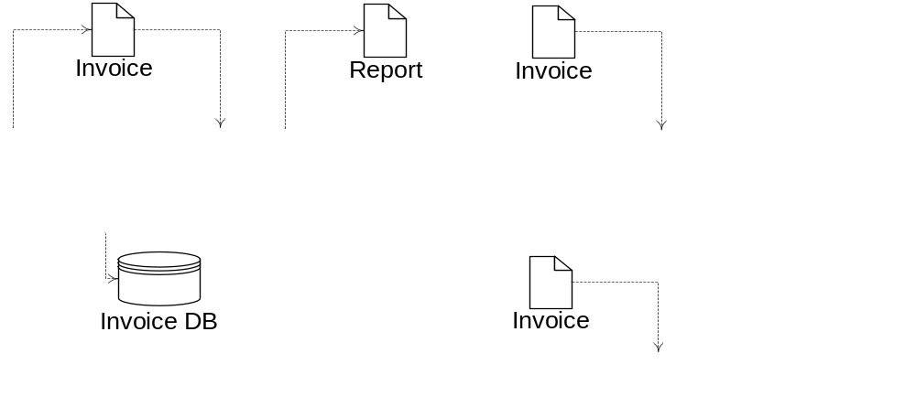

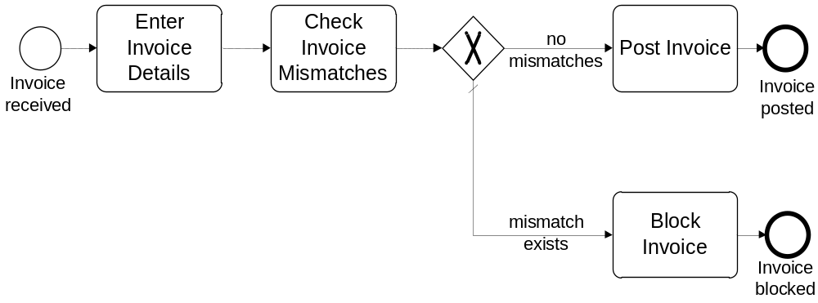
Process models – conveying transparency
  What we need to do and when – Control flow
  What we need to work on – Artifacts (physical & electronic)
  Who does the work – Resources (human & systems)

Slide 2
Key ingredients of a process model
What we need to do and when
  Activities, events and their order relationships
  Manual or automated
What we need to work on
  input/output artifacts to activities
  Physical or electronic
Who does the work
  Resources that perform activities and generate events
  Human or software

Slide 3

Further potential elements in a process
Objectives, goals
  to link with corporate strategy
Risks
  to risk-profile the process
Policies, rules
  to check process compliance
Knowledge
  to depict expertise required
…

Slide 4
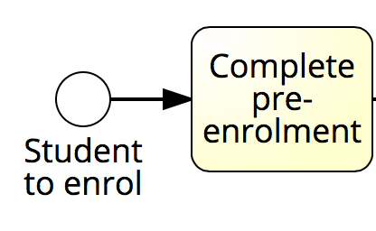
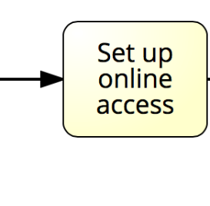
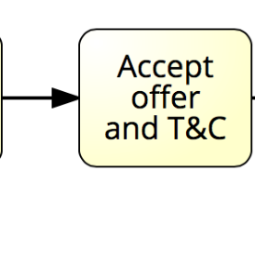
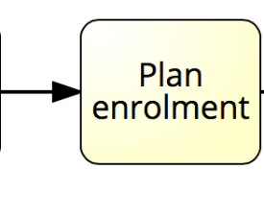
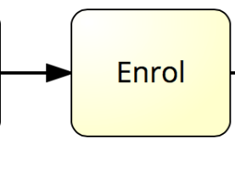
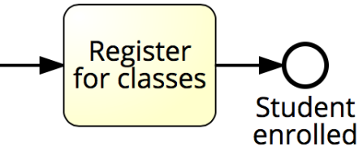
Example: Student Enrollment

Slide 5

What’s the right model?

Slide 6
How novices model
Mark is going on a trip to Sydney. He decides to call a taxi from home to the airport. The taxi arrives after 10 minutes, and takes half an hour for the 20 kilometers to the airport.
At the airport, Mark uses the online check-in counter and receives his boarding pass. Of course, he could have also used the ticket counter. He does not have to check-in any luggage, and so he proceeds straight to the security check, which is 100 meters down the hall on the right. The queue here is short and after 5 minutes he walks up to the departure gate.
Mark decides not to go to the Frequent Flyer lounge and instead walks up and down the shops for 15 minutes and buys a newspaper before he returns to the gate. After ten minutes waiting, he boards the plane.
Recker et al., How novices model business processes, Proceedings of BPM, Springer, 2010

Slide 7
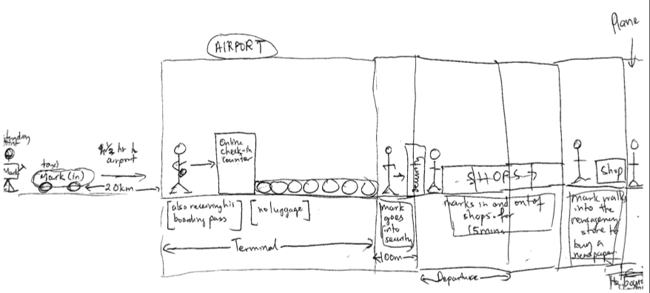
Some other ways of modelling...
Recker et al., How novices model business processes, Proceedings of BPM, Springer, 2010

Slide 8
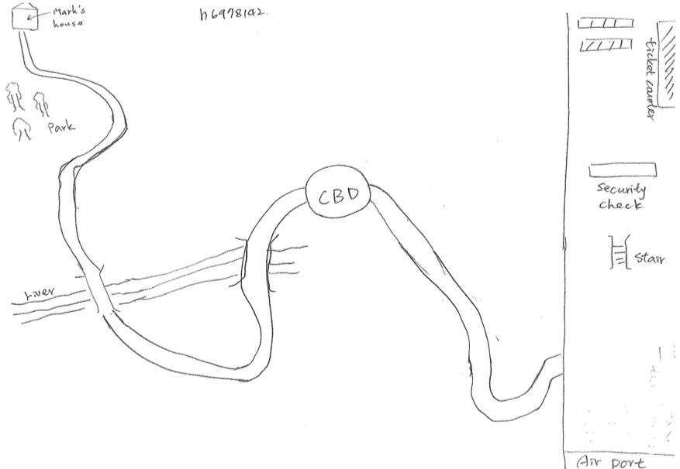
Some other ways of modelling...
Recker et al., How novices model business processes, Proceedings of BPM, Springer, 2010

Slide 9
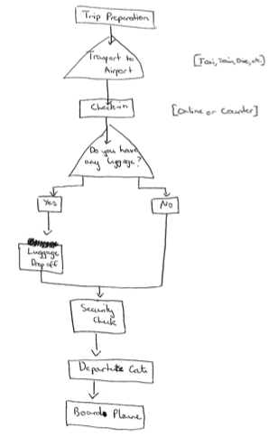
Some other ways of modelling...
Recker et al., How novices model business processes, Proceedings of BPM, Springer, 2010

Slide 10
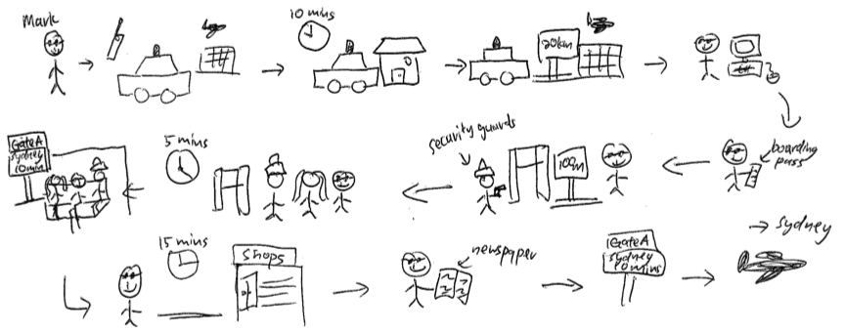
Some other ways of modelling...
Recker et al., How novices model business processes, Proceedings of BPM, Springer, 2010

Slide 11
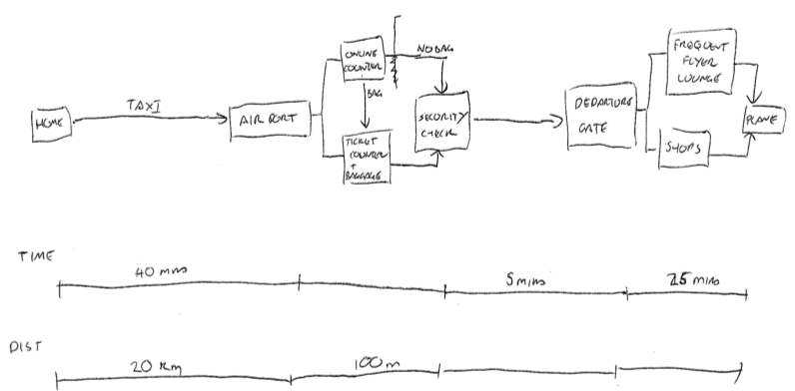
Some other ways of modelling...
Recker et al., How novices model business processes, Proceedings of BPM, Springer, 2010

Slide 12
Issues?
Different representation of concepts
Different level of granularity
Different level of scope
Different terminology
What is the right process model?

Slide 13
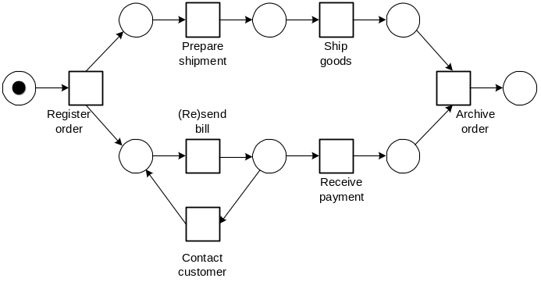


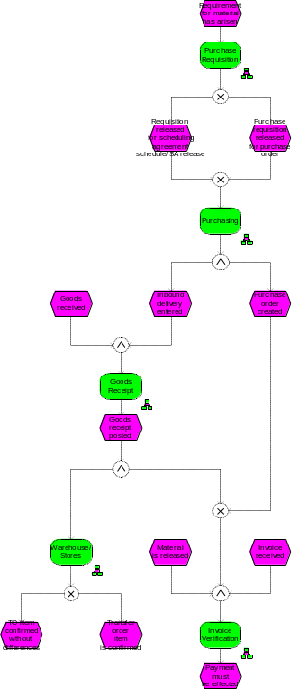
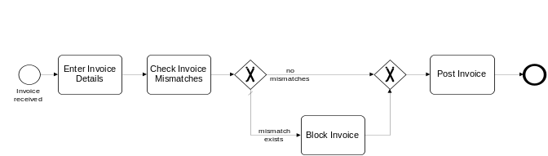
What is a model?

Slide 14

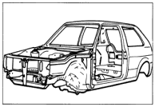

What’s a model? A little bit on modelling theory
Models are abstractions from real world phenomena,
developed for the purpose of reducing overall complexity.
Models aggregate information and document only relevant aspects of the real world
Models are being developed:
in a specific modelling subject
for a specific target audience
with a specific modelling purpose in mind

Slide 15
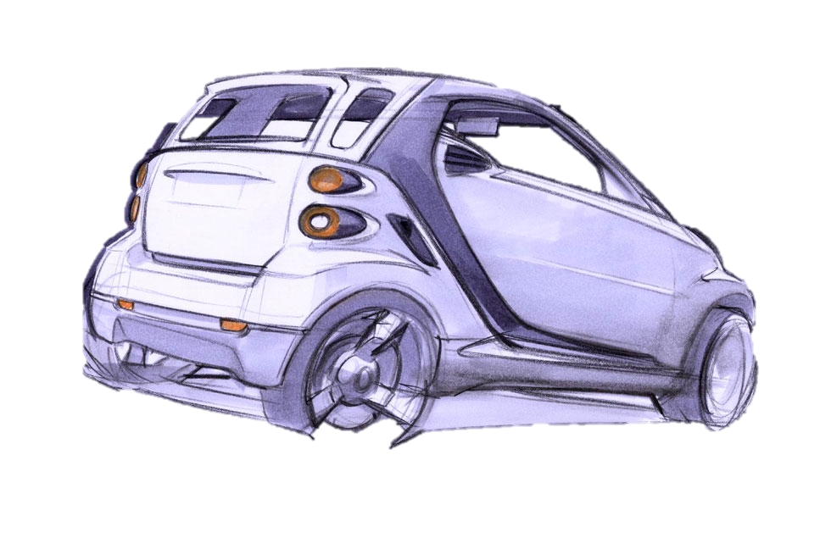

no right/wrong, but…
relevant/irrelevant model

Slide 16


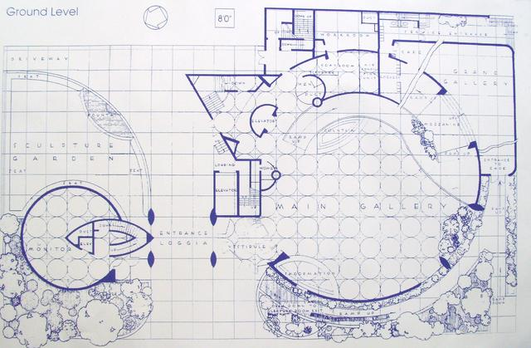
What’s the relevant model?
?

Slide 17
Model Definition
A model is a representation of some phenomenon of the real world made in order to facilitate an understanding of its workings.
Oxford Dictionary
What phenomenon matters?
How to represent this?
How to facilitate understanding?

Slide 18
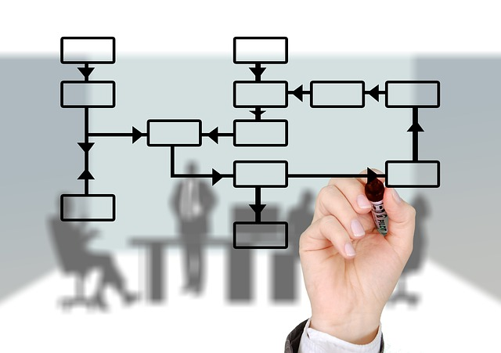
Our phenomenon of interest: Business Process

Slide 19
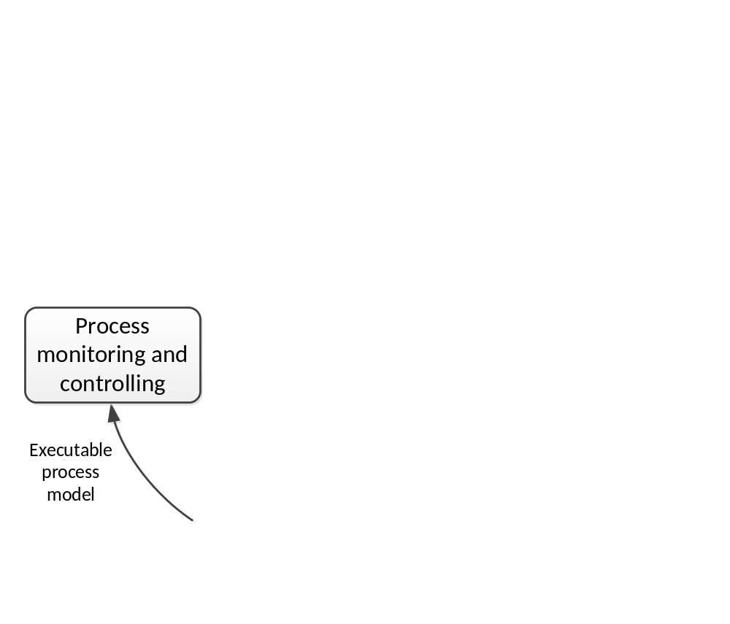
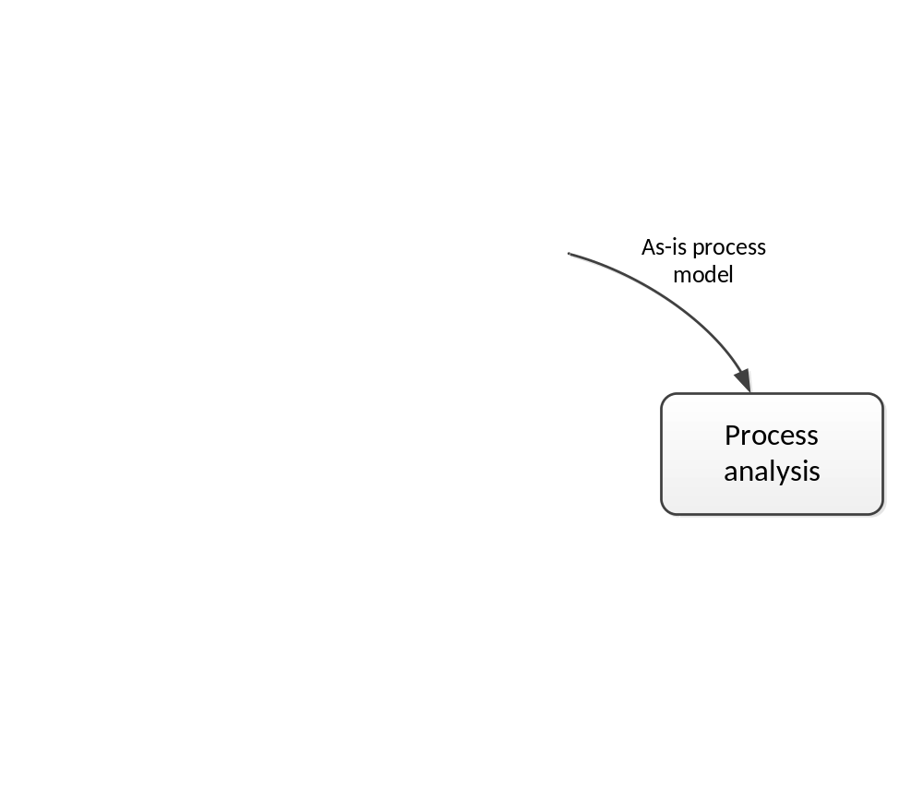
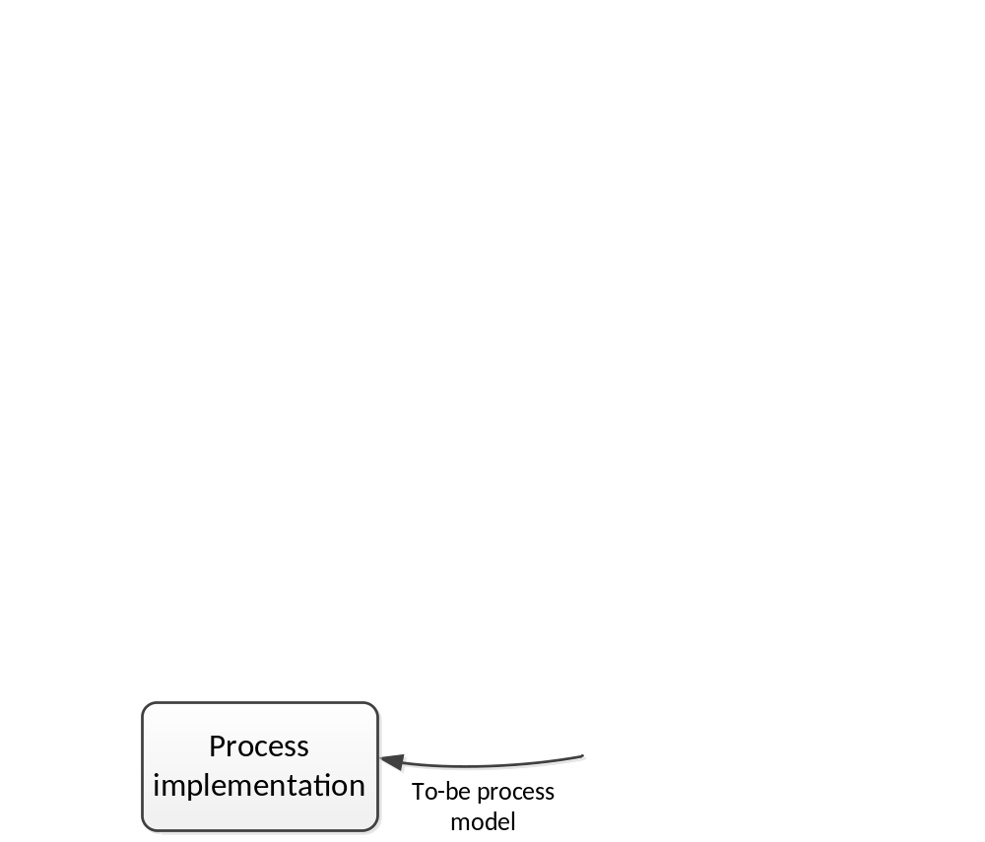
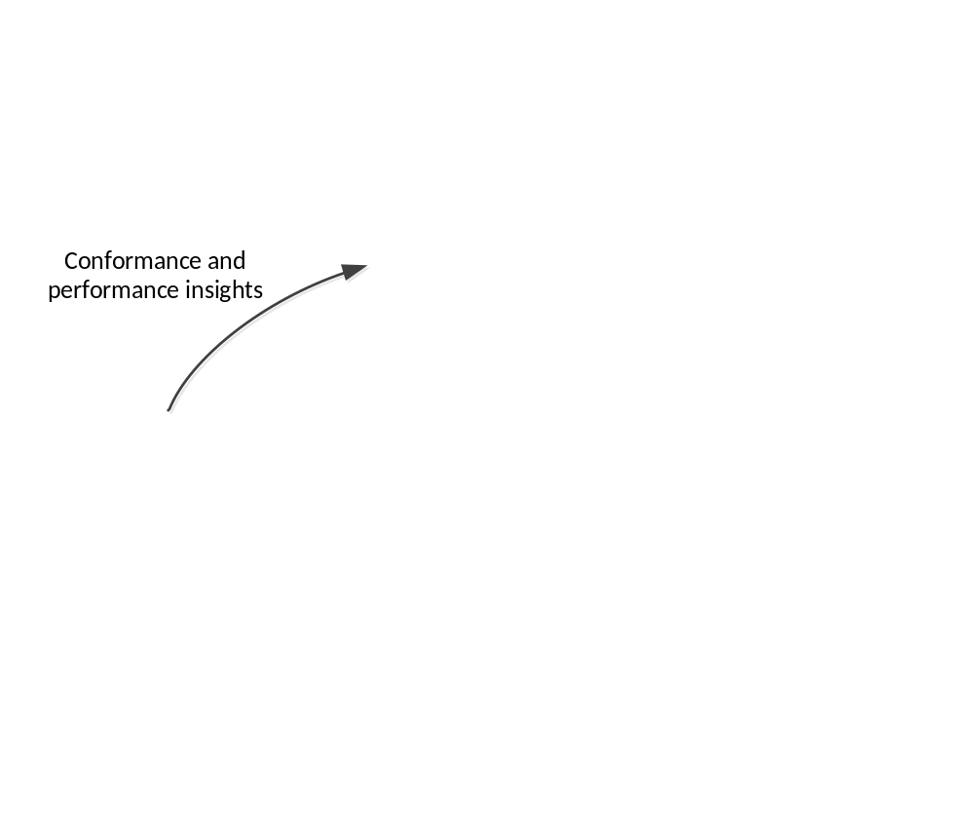
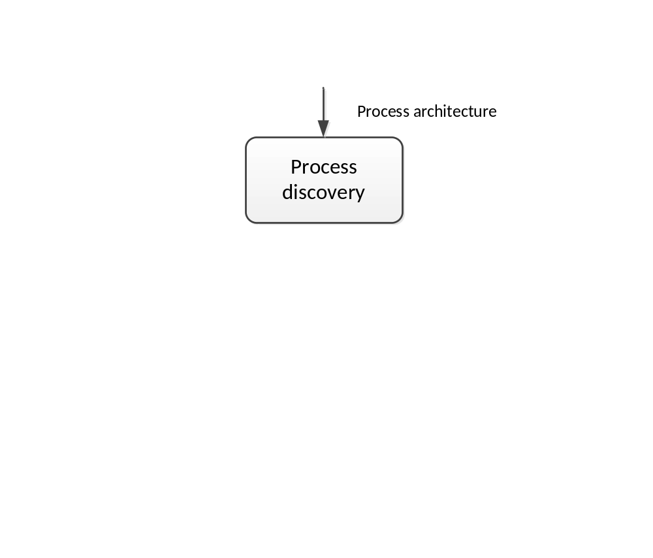
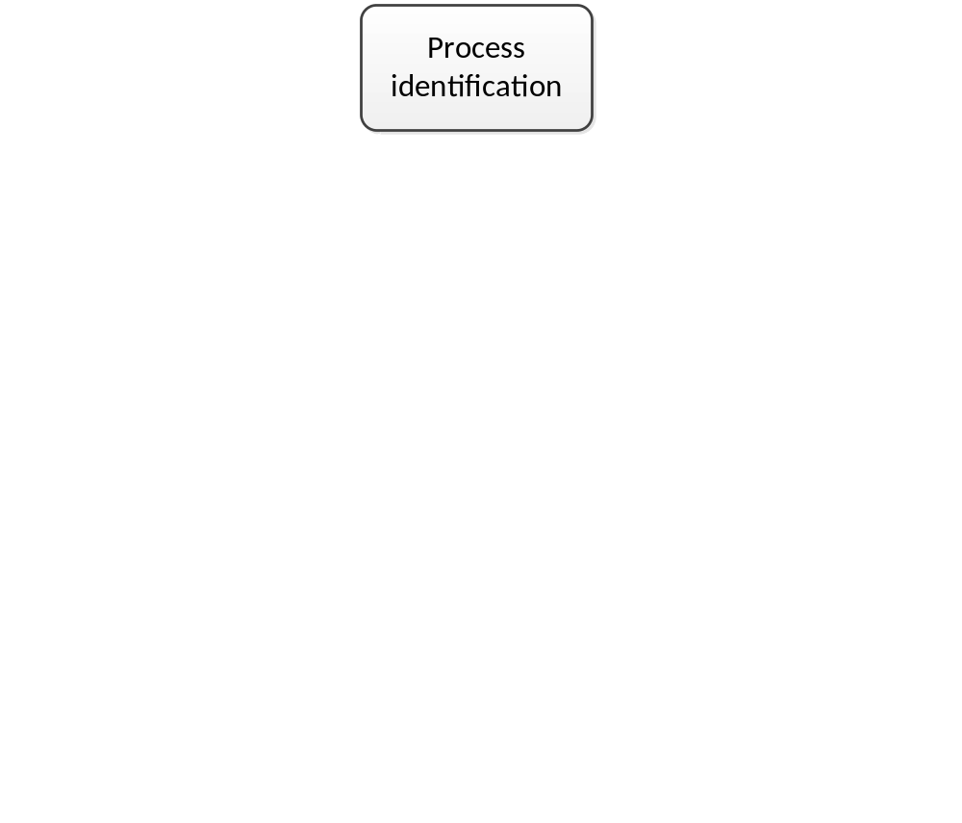
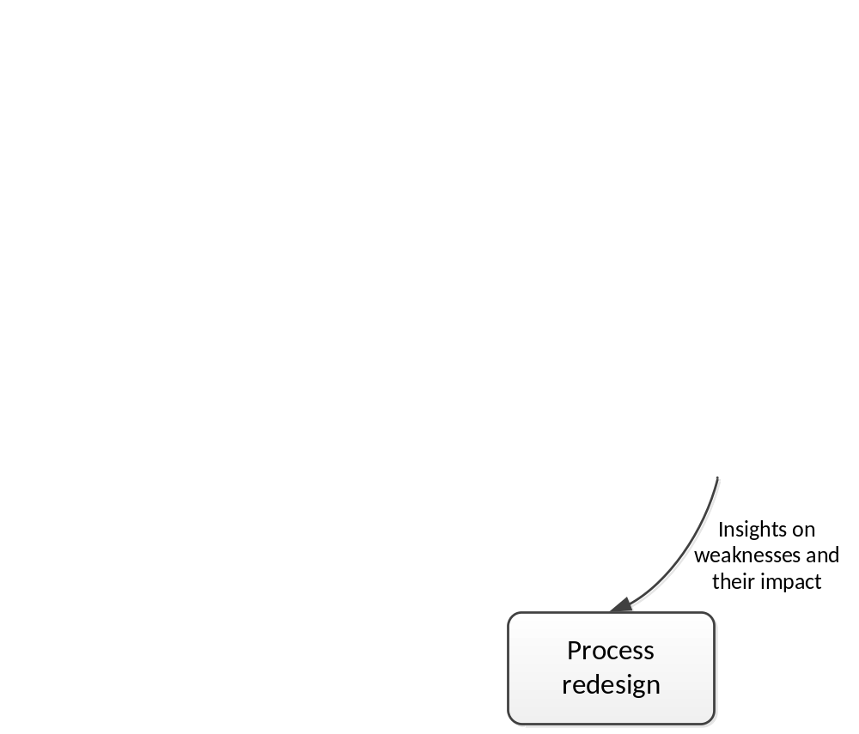

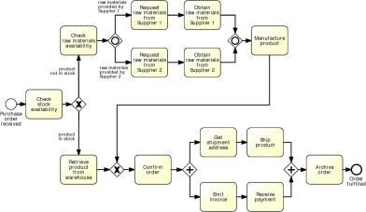
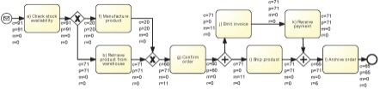
Purposes of process modeling
documentation
communication
activity-based costing
simulation...
benchmarking
certification
workflow management
software development
integration
testing
…

Slide 20


Purposes of Process Modeling
Organization
design
Application system
design
workflow
management
documentation
communication
software
development
activity-
based
costing
integration
Transparency
simulation
testing
…
benchmarking
certification
…

Slide 21

Different stakeholders have different interests…
Business stakeholders
Process innovation, operational excellence
KPIs, customer touch-points, issues, opportunities, risks
Balanced Scorecard, Activity-based costing
Animation, simulation, scenario analysis,
easy communication…
IT stakeholders
Process-Aware Information Systems
Process automation
Expressive, executable, standardized models
Data types, conditions, data mappings, faults handling…

Slide 22
The result: two sides of the story
Conceptual process models
  are made by domain experts
  provide a basis for communication amongst relevant stakeholders
  must be understandable
  must be intuitive and may leave room for interpretation
  contain purely a relevant set of process information
Executable process models
  are made by IT experts
  provide input to a process enactment system - BPMS
  must be machine readable
  must be unambiguous and should not contain any uncertainties
  contain further details that are only relevant to implementation

Slide 23
How to model: the BPMN language

Slide 24

Business Process Model and Notation (BPMN)
OMG standard (nowadays BPMN 2.0)
Supported by numerous tools: bpmn.org lists over 70 tools (Jan 15)
Both for conceptual and executable models

Slide 25
Objective of the BPMN initiative
Modelling Purpose Target Audience
Organisational design
Managers/Strategy Consultants
Process Owners
Scope
Business Analysts
Solution Architects
Application system design
Software Developers

Slide 26





BPMN from 10,000 miles…
Based on popular graphical flowcharts:
Core set of notation elements
Each core element has various subtypes
A BPMN process model is a graph consisting of four types of core elements:
start
end
activity
event
gateway
sequence flow

Slide 27
Let’s start modeling
Order-to-cash
A typical order-to-cash process is triggered by the receipt of a purchase order from a customer. The purchase order has to be checked against the stock regarding the availability of the item(s) requested. Depending on stock availability the purchase order may be confirmed or rejected.
If the purchase order is confirmed, an invoice is emitted and the goods requested are shipped. The process completes by archiving the order or if the order is rejected.

Slide 28

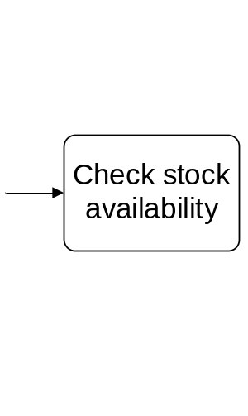
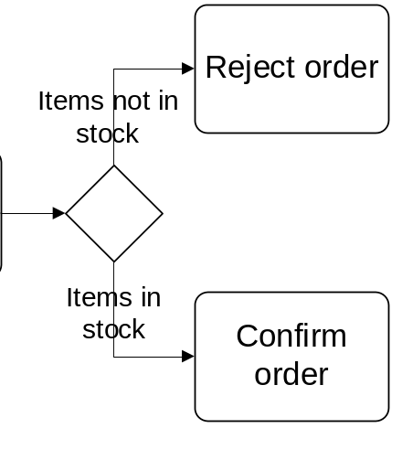
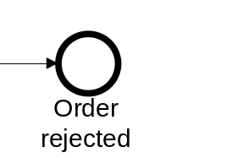
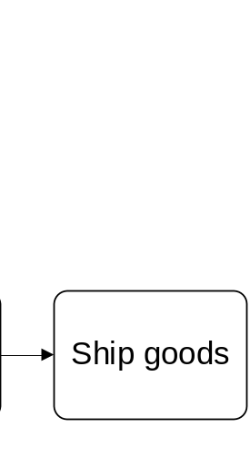
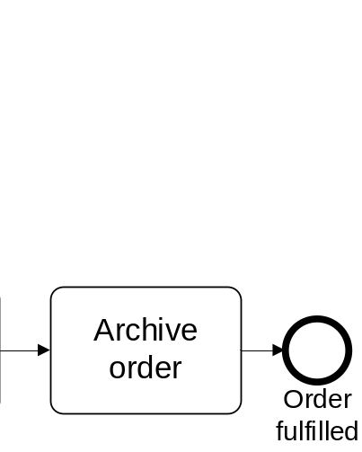
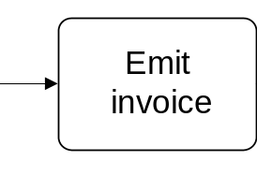
Solution in BPMN
Order-to-cash
end
event
activity
split gateway
end
event
start
event
Naming conventions
Event: noun + past-participle verb (e.g. insurance claim lodged)
Activity: imperative verb + noun (e.g. assess credit risk)

Slide 29
One more example
Handle down payments
This process starts when a request for down payment has been approved.
It involves the entry and posting of a down payment in the form of a down payment request being entered into the system, the automatic subsequent payment, acquittal of the down payment through the processing of the direct invoice and the clearance of the vendor line items.
The clearance of the vendor line items can result in a debit or credit balance. In case of debit balance, the arrears are processed, otherwise the remaining balance is paid.

Slide 30
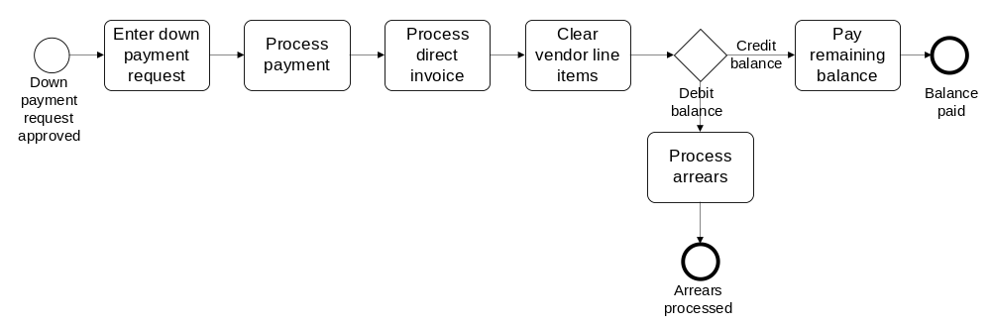
Solution in BPMN
Handle down payments

Slide 31
BPMN core elements
Activities capture work performed in a process
  Different types of activities
Events represent the process’ triggers (start event) and outcomes (end event).
  Different types of events
activity
start
event
end
event

Slide 32
BPMN core elements
Gateways capture forking and joining paths in the control flow.
  Different types of gateways
Sequence flows represent the order in which activities and events will be performed.
They can be assigned a condition to distinguish between alternative branches.
  Different types of flows
gateway
sequence
flow

Slide 33
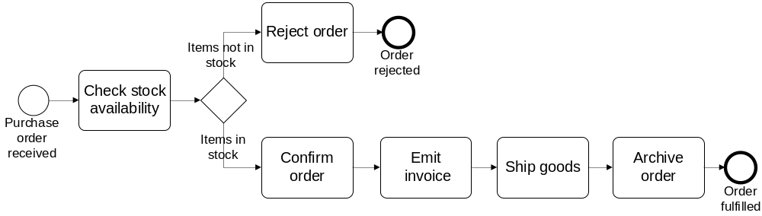
Process model vs process instances –
The tokens game
Order #1
Order #2
Order #3

Slide 34
A little bit more on events…
A start event triggers a new process instance
by generating a token that traverses the
sequence flow (“tokens source”)
An end event signals that a process instance has
completed with a given outcome by consuming
a token (“tokens sink”)
start
event
end
event

Slide 35
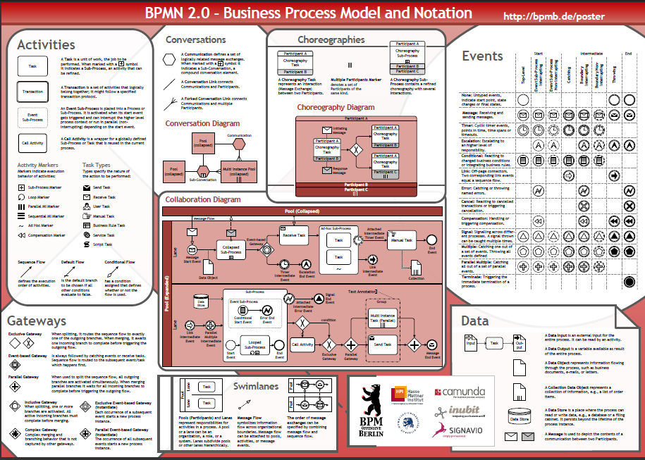
BPMN Poster

Slide 36

Readings for Week 2
Required
Dumas M., La Rosa M., Mendling J., Reijers, H. (2013):
Fundamentals of BPM. Chapter 3 Section 3.1 (including box “A bit on modeling theory”)
Recker J., Safrudin N., Rosemann M., How novices model business processes, Proceedings of BPM, Springer, 2010
Recommended

